Slide 1
High-throughput in silico characterization of astrocyte-neuron cell cultures
Maria Beatriz Sereno Fernandes
2nd Cycle Integrated Project in
Biomedical Engineering
Supervisor(s): Prof. Rui Henriques
Dr. Thomas Distler
Examination Committee:
Supervisor: Prof. Rui Miguel Carrasqueiro Henriques
Member of the Committee: Prof. Daniel Faria
Notes:
Hello everyone. Today I’m here to present my project entitled high-throughput in silico characterization of astrocyte-neuron cell cultures.
This project was conducted under the supervision of Prof. Rui Henriques and is introductory to my Master thesis which I'll conduct at the Helmholtz Zentrum München at the Götz Lab from the Institute of Stem Cell Research, under the supervision of Dr. Thomas Distler and Dr. Giacomo Masserdotti.

Slide 2
Table of Contents
01
02
03
Introduction
Background
Related Work
Motivation, Objectives, Deliverables
Machine Learning, Deep Learning, CNNs
Image Classification, Object Detection, Image Segmentation, In Silico Staining
04
05
Solution Proposal and Preliminary Results
Conclusions
Nuclei Segmentation, Astrocyte Classification Tasks
Achievements,
Future Work
1

Slide 3
01
Introduction
Motivation, Objectives, Deliverables
2

Slide 4

Götz Group Neural Stem Cells
“aims to elucidate the key mechanisms of neurogenesis in the developing and adult brain”
“pioneered the approach to generate new neurons by direct reprogramming from glial cells”
“approach for novel therapeutic approaches to brain repair”
(Helmholtz Zentrum München, 2022)
3
Notes:
The Götz Lab efforts, which I will integrate starting on March, are focused on elucidating the key mechanisms of neurogenesis in the developing and adult brain. In particular, they have pioneered the approach to generate new neurons by direct reprogramming from glial cells which has now become a world-wide very active field of research for novel therapeutic approaches to brain repair.
In this project we draw attention to astrocytes cell cultures.

Slide 5
Motivation
ASTROCYTES
CHARACTERIZATION
of astrocyte cultures
CHALLENGES
for automatization
Maintaining homeostasis
Structural and metabolic functions in the brain
Integration of new neurons into existing neural circuits
Neural cell precursor through dedifferentiation both in vivo and in vitro
Detection
Segmentation
Morphological analysis
Spatial profiling
Cell-cell contacts
Classification
Scarcity of annotated data (specially of 3D images)
Astrocytes’ morphological complexity
Astrocytes’ heterogeneity
Laboratory-specific experimental conditions
Astrocytes are fundamental to understand neurogenesis
4
Notes:
These cells are abundant in the central nervous system and are renowned for multiple metabolic, structural, homeostatic functions in the brain, in addition to being a neural cell precursor through a process of dedifferentiation. This way, there arises a compelling need to thoroughly understand their underlying mechanisms to unravel the mechanisms underpinning neurogenesis itself.
This necessity has been established by several laboratories, in which the main focuses rely on the detection, segmentation, morphological analysis, spatial profiling, cell-cell contacts, and classification of astrocyte and astrocyte-neuron cultures.
Manual techniques are often hampered by the increasing complexity of the datasets, thus pushing the incorporation of high-throughput automated analysis into modern laboratories. However, automatizing the astrocytes characterization is also currently limited: firstly, due to the scarcity of annotated data; and secondly due to their morphological complexity, heterogeneity as a cell population, emphasized by laboratory-specific experimental conditions.

Slide 6
Motivation
ASTROCYTES
CHARACTERIZATION
of astrocyte cultures
Maintaining homeostasis
Structural and metabolic functions in the brain
Integration of new neurons into existing neural circuits
Neural cell precursor through dedifferentiation both in vivo and in vitro
Detection
Segmentation
Morphological analysis
Spatial profiling
Cell-cell contacts
Classification
Astrocytes are fundamental to understand neurogenesis

Slide 7
Motivation
CHARACTERIZATION
of astrocyte cultures
CHALLENGES
for automatization
Detection
Segmentation
Morphological analysis
Spatial profiling
Cell-cell contacts
Classification
Astrocytes’ morphological complexity
Astrocytes’ heterogeneity
Laboratory-specific experimental conditions
Scarcity of annotated data (specially of 3D images)

Slide 8
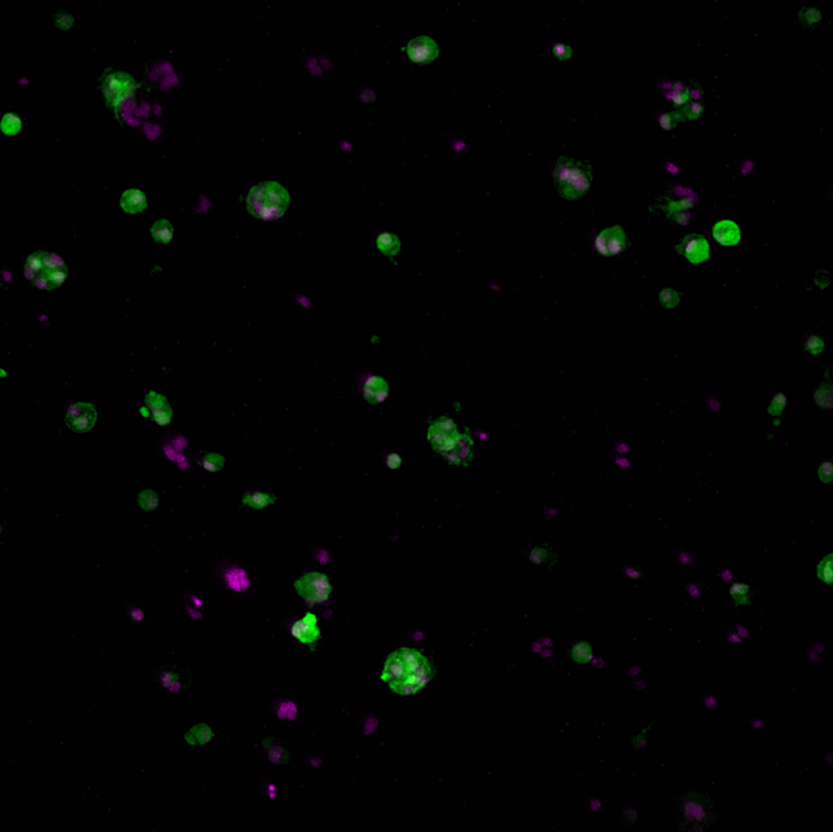
Objectives and Deliverables
High-throughput
In Silico Characterization Pipeline
Confocal microscopy platform
Nuclei quantification
Astrocyte detection
Astrocyte classification
Protoplasmic-like or fibrous-like?
Mononucleated or multinucleated?
Cell-cell interactions
In silico staining
Quantification, classification, cell-cell interactions, in silico staining
Astrocyte-Neuron Cell Cultures
Murine-derived astrocytes embedded in 3D hydrogels
Figure 1. Illustrative maximum projection astrocyte culture image from the dataset provided (image 16).
5
Notes:
The objectives for my Master thesis are divided into three parts. Firstly, I will develop an in silico pipeline to characterize astrocyte cultures. Our primary goals will be to perform nuclei quantification, astrocyte identification, and classification of astrocytes based on morphological features and multinucleated state. In addition, we will also potentially aim to characterize cell-cell interactions and perform in silico staining of transmitted-light microscopy images.
The project I have conducted in the last semester focused mainly in exploring the fundamental concepts required to perform this characterization and exploring the tools available to do so.
For the Master thesis itself, this work will be pursued and additionally I’ll also start the wet-lab experiments involving the cultivation of murine-derived astrocytes in 3D hydrogels. The final goal will be to establish a high-throughput confocal microscopy platform to streamline the acquisition of images of our cultures and characterize them automatically with our deep learning pipeline, thus accomplishing a high-throughput in silico characterization of astrocyte-neuron cell cultures.

Slide 9
Objectives and Deliverables
In Silico Characterization Pipeline
Nuclei quantification
Astrocyte detection
Astrocyte classification
Protoplasmic-like or fibrous-like?
Mononucleated or multinucleated?
Cell-cell interactions
In silico staining
Figure 1. Illustrative maximum projection astrocyte culture image from the dataset provided (image 16).

Slide 10
Objectives and Deliverables
High-throughput
Confocal microscopy platform
In Silico Characterization Pipeline
Quantification, classification, cell-cell interactions, in silico staining
Astrocyte-Neuron Cell Cultures
Murine-derived astrocytes embedded in 3D hydrogels
Figure 1. Illustrative maximum projection astrocyte culture image from the dataset provided (image 16).

Slide 11
02
Background
Machine learning, Deep Learning, Convolutional Neural Networks (CNNs)
6

Slide 12
Artificial Intelligence
Machine Learning (ML)
Deep Learning (DL)
Approaches to automatically detect patterns within data.
Representation-based methods that can automatically uncover data representations necessary for each learning task.
Used in more complex data domains.
Artificial Intelligence
ML
DL
Figure 2. Artificial Intelligence, Machine Learning and Deep Learning.
7
Notes:
Machine learning is a branch of artificial intelligence, which deploys several approaches to automatically detect patterns within data. Machine learning is great at learning predictors and descriptors for simple data, such as multivariate data, however, in more complex data domains it usually underperforms. In these scenarios, deep learning is a better approach, since they are representation-based methods that can automatically uncover data representations necessary for each learning task.

Slide 13
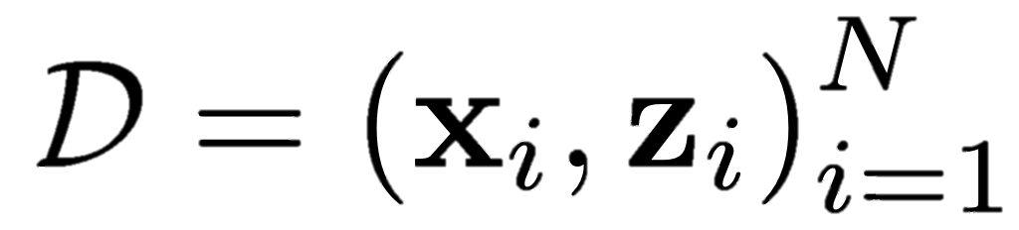
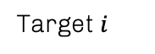
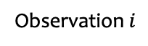
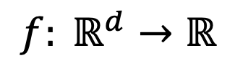
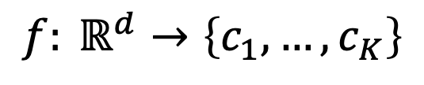
Supervised Learning
Unsupervised Learning
Classification problem
Mostly used by predictors
Predict label/category
$$f: ℝ^{d}→\left\{c_{1}, …, c_{K}\right\}$$
Observation $i$
Target $i$
Regression problem
Mostly used by descriptors
Predict numeric value
$$f: ℝ^{d}→ℝ$$
8
Notes:
But rewinding a little bit, learning tasks can be divided into supervised and unsupervised learning. While in supervised learning the expected output is known and the objective is to map a function from the observations to a target, in unsupervised learning, the output is unknown. This way, supervised learning is mostly used for predictors and unsupervised learning in descriptors.
On the other hand, machine learning problems can be casted as classification or regression problems. As the names suggest, classification problems aim to predict a categorical output, while regression problems predict a numerical output.

Slide 14
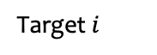
Supervised Learning
Unsupervised Learning
Mostly used by predictors
Observation $i$
Target $i$
Mostly used by descriptors

Slide 15
Classification problem
Regression problem
Predict label/category
$$f: ℝ^{d}→\left\{c_{1}, …, c_{K}\right\}$$
Predict numeric value
$$f: ℝ^{d}→ℝ$$

Slide 16

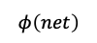
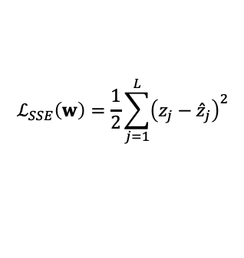
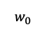
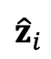
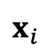
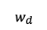
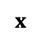
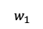
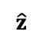
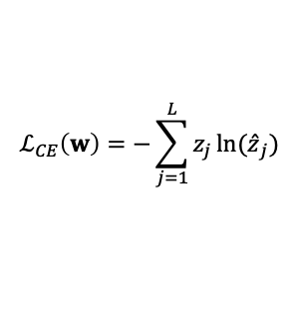
Artificial Neural Networks
Input
layer
Hidden layers
Output
layer
$$x_{i}$$
$${\hat{z}}_{i}$$
Perceptrons are ANNs basic units
Minimize loss function
1
bias
$$w_{0}$$
activation function
$$w_{1}$$
$$φ\left(net\right)$$
$$\hat{z}$$
…
…
$$x$$
…
$$w_{d}$$
weights
Figure 4. Representation of a perceptron.
…
…
$$ℒ_{SSE}\left(w\right)=\frac{1}{2}\sum_{j=1}^{L}{{\left(z_{j}−{\hat{z}}_{j}\right)}^{2}}$$
$$ℒ_{CE}\left(w\right)=−\sum_{j=1}^{L}{z_{j}\ln{{(\hat{z}}_{j})}}$$
Figure 3. Simplified representation of an artificial neural network.
regression
classification
8
Notes:
So, at the core of deep learning models are artificial neural networks, which are computational models inspired by the structure and functioning of the brain and use perceptrons as their basic units. They possess the ability to effectively model both regression and classification problems by learning network weights that minimize a loss function, associated with the error between the estimation and the targets. Thus, deep learning models are supervised learning approaches.

Slide 17
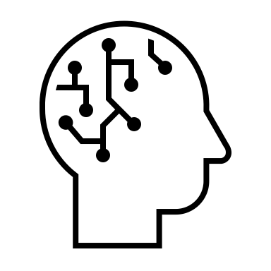
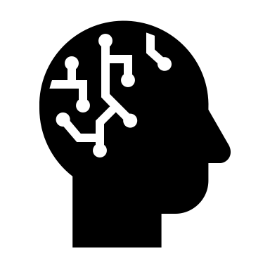

Training and Data scarcity
Dataset Augmentation
Transfer Learning
Fine-Tuning
Create synthetic data
Translation, rotation, scaling, cropping, noise injection, …
Preserve weights of the first layers
Train predictor layers
Weights are retrained in the new dataset
Network fully adapted to the new dataset
9
Notes:
But, training a robust deep learning network requires a substantial amount of annotated data. In the field of biology this is particularly challenging because data collection is typically labor-intensive and costly. This way, data augmentation, transfer learning and fine-tuning are valuable tools to improve the model’s efficiency.
On the one hand, data augmentation is used to create synthetic data from the original dataset with relatively simple transformations, such as translation, rotation, scaling, cropping, noise injection, etc.
On the other hand, transfer learning is a technique which takes advantage of a pre-trained model to learn a new task faster and with lower amount of data. The traditional transfer learning typically preserves the first layers of a previously trained model and trains the predictor layers with the problem-specific features.
Fine-tuning is a form of transfer learning. Instead of fixing the weight values of the pretrained model, it unfreezes some of the layers phasedly to make them adaptable to the dataset.

Slide 18
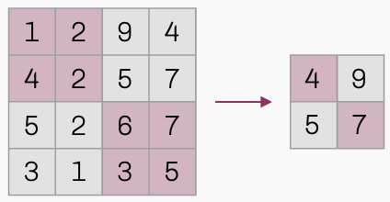

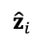
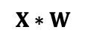

Convolutional Neural Networks
Fully-connected layer
Output
layer
Flatten
Input image
$${\hat{z}}_{i}$$
Convolution
Pooling
kernel
$$W$$
…
$$X$$
…
…
Feature maps
Max pooling
$$X∗W$$
Figure 5. Simplified representation of a typical convolutional neural network.
10
Notes:
In deep learning, there exist diverse architectures designed to respond to specific problem domains. In this project, we will be working with image processing, thus convolutional neural networks are the most suitable architecture.
Convolutional neural networks employ convolution functions to draw relations in data. Multiple convolutional-polling layers allow to discern complex feature relations and predict an output.

Slide 19
Convolutional Neural Networks
Input image
Convolution
Pooling
kernel
$$W$$
$$X$$
Feature maps
Max pooling
$$X∗W$$
1 | 2 | 9 | 4
4 | 2 | 5 | 7
5 | 2 | 6 | 7
3 | 1 | 3 | 5
4 | 9
5 | 7

Slide 20
Convolutional Neural Networks
Fully-connected layer
Output
layer
Flatten
$${\hat{z}}_{i}$$
…
…
…

Slide 21
Convolutional Neural Networks
Sparse interactions
The neurons are not all connected
Uses a kernel
Detection of meaningful features
Parameter sharing
Applies the same kernel to multiple image regions
Equivariance to translation
Changes in the input are changed equally in the output
11
Notes:
This way, CNNs are characterized by their sparse interactions, parameter sharing and equivariance to translation.

Slide 22
03
Related work
Image Classification, Object Detection, Image Segmentation, In Silico Staining
12

Slide 23
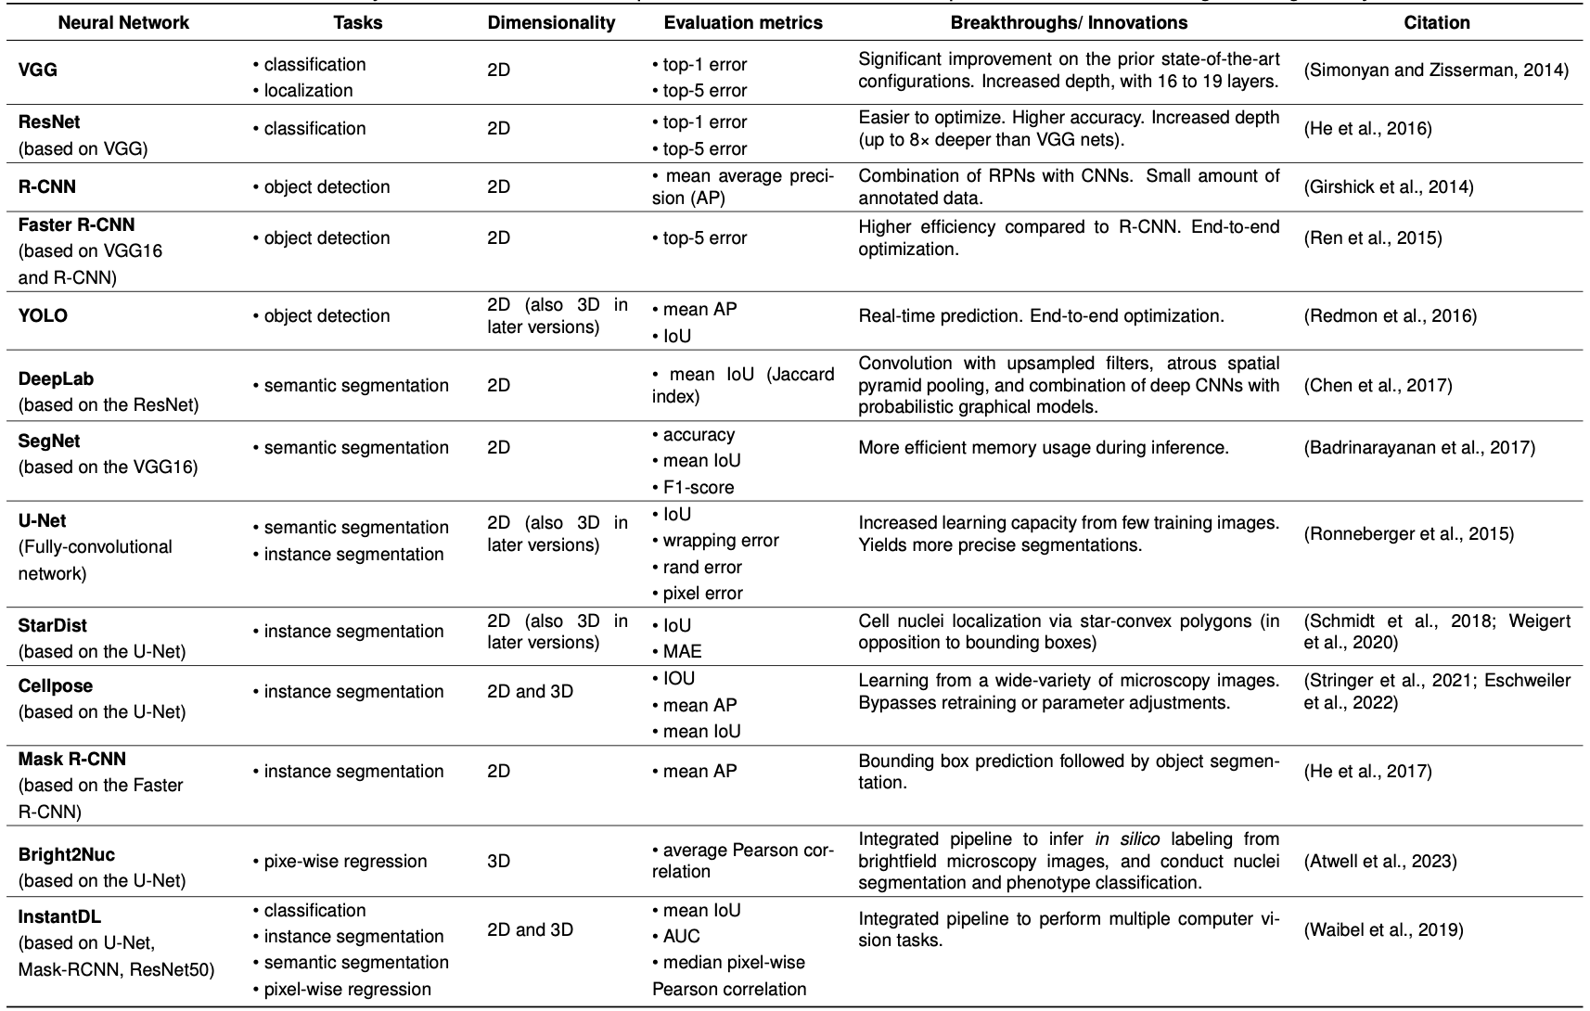
Table 1. Summary of the most common deep neural networks used for computer vision tasks in biological image analysis.
Neural Networks
13
Notes:
In this project I’ve conducted a thorough literature review over the most used CNN architectures for image classification, object detection, image segmentation and in silico staining.

Slide 24
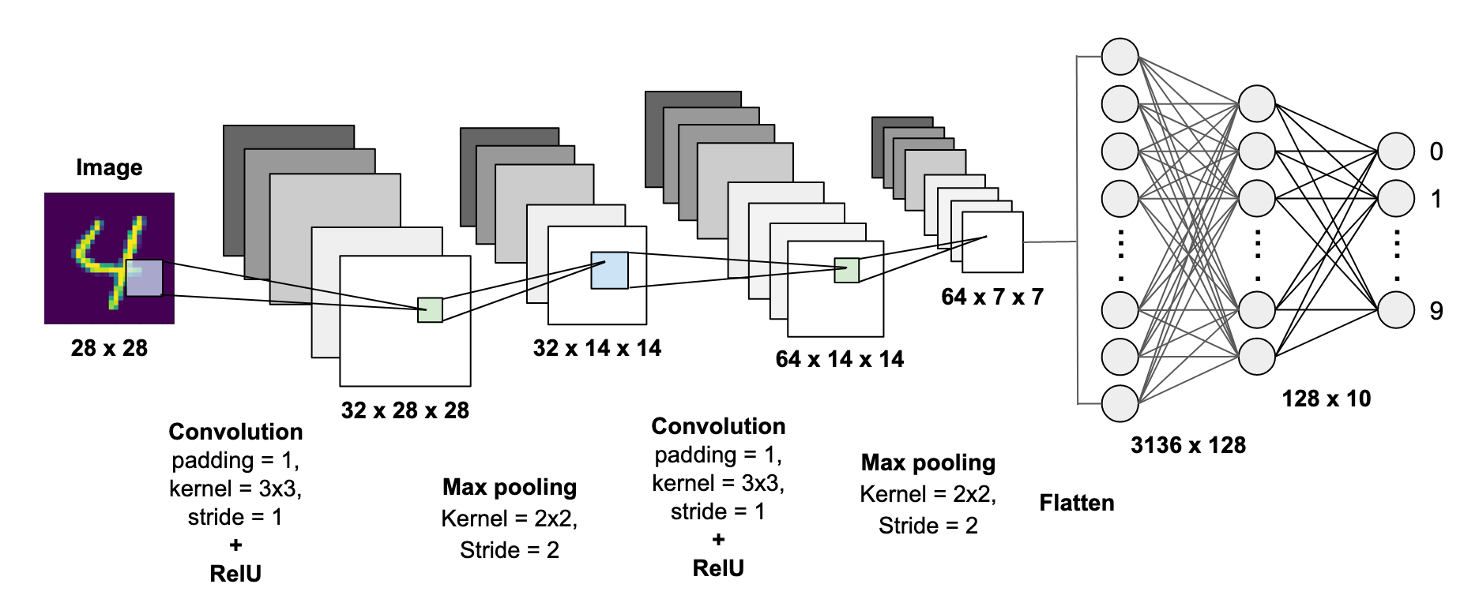
Image Classification
Figure 6. MNIST handwritten digits image classification using a CNN (Dwivedi, 2020).
14
Notes:
In image classification tasks, the goal is to assign a target label to each observation.

Slide 25
Table 1. Summary of the most common deep neural networks used for computer vision tasks in biological image analysis.
Neural Networks

Slide 26
Table 1. Summary of the most common deep neural networks used for computer vision tasks in biological image analysis.
Neural Networks
13
Notes:
VGG and ResNets were singled as the two pioneer architectures for image classification. Nevertheless, they have also been successfully adapted for other computer vision tasks such as object detection and image segmentation.

Slide 27
Table 1. Summary of the most common deep neural networks used for computer vision tasks in biological image analysis.
Neural Networks
13
Notes:
On the other hand, object detection is the task of pinpointing objects within an image using bounding boxes and assigning corresponding labels. R-CNNs and YOLO networks are the most popular approaches due to their stable performance and coherent results across multiple validated datasets.

Slide 28
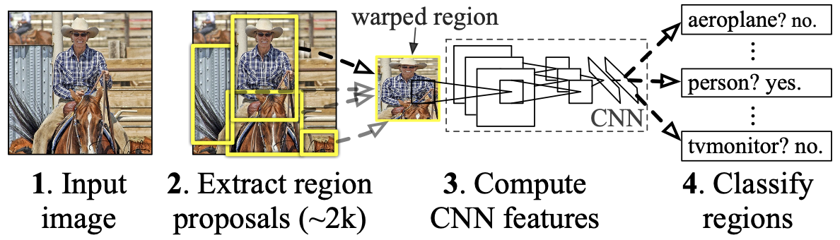
Region Proposal CNN (R-CNN)
R-CNN
Slow
No end-to-end optimization
Figure 7. Object detection modules of R-CNN (Girshick et al., 2014).
Faster R-CNN
End-to-end optimization
Region Proposal Network (RPN) + Fast R-CNN
More efficient than traditional R-CNN
15
Notes:
R-CNNs are region proposal algorithms combined with CNNs. This approach involves three distinct modules. The first module generates region proposals, and it is followed by a large CNN to extract feature vectors. The last module does object classification using class-specific linear SVMs.
Faster R-CNN, is a later improvement of R-CNN and consists of two networks that can be optimized end-to-end with higher efficiency.

Slide 29
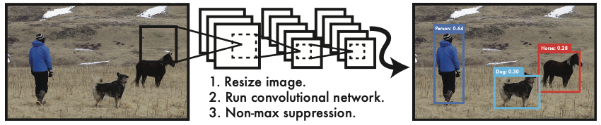
You Only Look Once (YOLO)
Figure 8. YOLO detection system (Redmon et al., 2016).
Object detection as a regression problem
Predicts bounding boxes and class probabilities simultaneously
Real-time object detection
Looks at the entire image at once
16
Notes:
YOLO on the other hand, frames object detection as a regression problem. It looks at the whole image at the same time allowing real-time object detection. There are already available new versions of the originally proposed. In particular, I found that YOLOv5 and YOLOv8 have been used in the literature for tasks similar to the ones I aim to employ.

Slide 30
Table 1. Summary of the most common deep neural networks used for computer vision tasks in biological image analysis.
Neural Networks
13
Notes:
Moving to image segmentation...

Slide 31
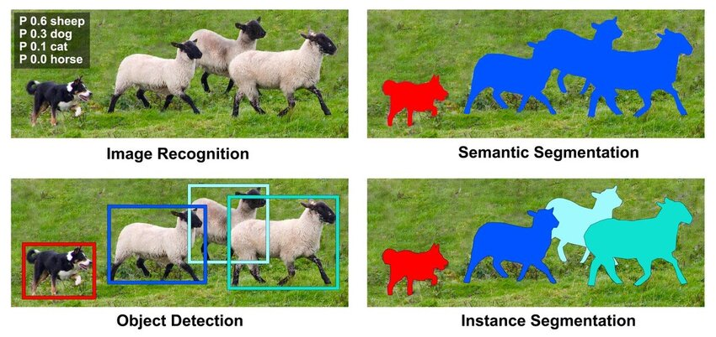
Image Segmentation
Figure 9. Instance and semantic segmentation. Adapted from Liu et al., 2022.
SegNet
DeepLab
U-net
Mask R-CNN
16
Notes:
, its purpose is to perform pixel-wise classification, discerning objects from the background. It can be casted into 2 different tasks.
Semantic segmentation simply aims to distinguish background from objects categories. Deep lab and SegNet, are based on ResNets and VGG architectures and perform this task. However, in this work we are mostly concerned with instance segmentation task as to delineate each instance of the image separately.

Slide 32
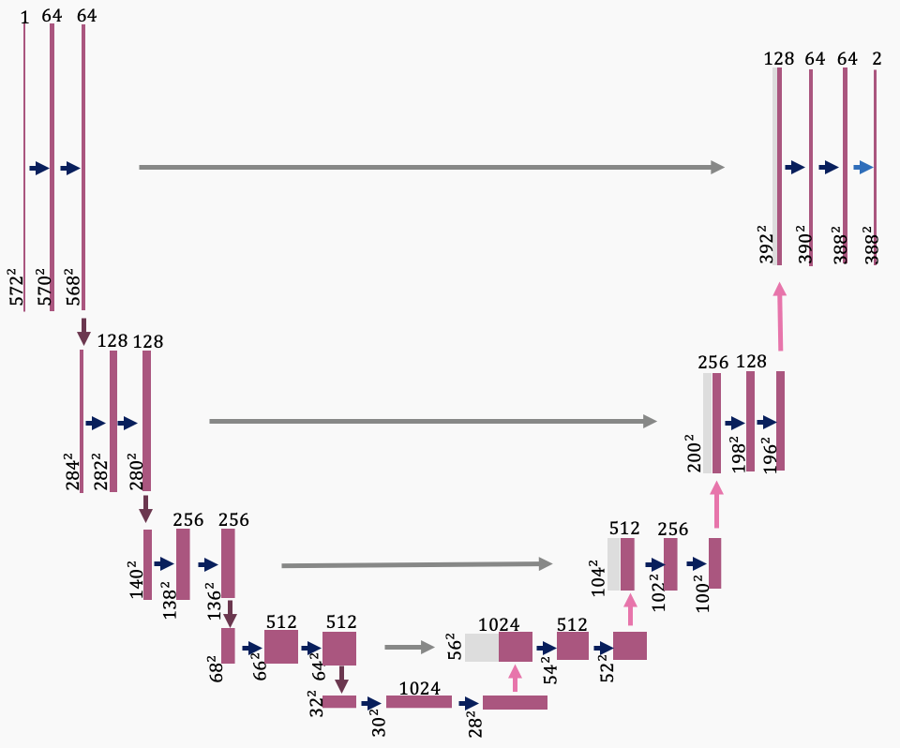
U-Net
convolutional layers
Fully convolutional architecture
Instance and semantic segmentation
Few training parameters
Very efficient
StarDist 2D
Cellpose 2D
copy and crop
pooling layers
upsampling layers
ENCODER
DECODER
Figure 10. U-net visual representation. Inspired in Ronneberger et al., 2015.
17
Notes:
For this, U-Nets are acknowledged to be one of the best approaches. The traditional U-net has a two-dimensional fully convolutional architecture, consisting of an encoder, followed by a decoder. It is very efficient at training due to few training parameters and yields very precise segmentations.
It served as a template for multiple segmentation deep networks, including StarDist and Cellpose, which I have employed in this work.

Slide 33
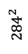
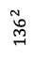
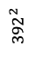
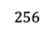
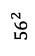
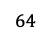
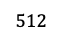
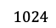
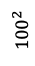
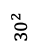
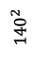
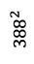
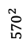
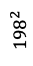
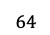
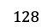
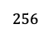
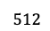
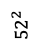
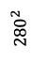
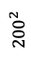
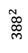


























$$1$$
$$64$$
$$64$$
$$128$$
$$64$$
$$64$$
$$2$$
$${392}^{2}$$
$${390}^{2}$$
$${388}^{2}$$
$${388}^{2}$$
$${572}^{2}$$
$${568}^{2}$$
$${570}^{2}$$
$$128$$
$$128$$
$$256$$
$$128$$
$${200}^{2}$$
$${198}^{2}$$
$${282}^{2}$$
$${280}^{2}$$
$${196}^{2}$$
$${284}^{2}$$
$$256$$
$$256$$
$$512$$
$$256$$
$${140}^{2}$$
$${104}^{2}$$
$${102}^{2}$$
$${100}^{2}$$
$${138}^{2}$$
$${136}^{2}$$
$$512$$
$$512$$
$$1024$$
$$512$$
$${56}^{2}$$
$${68}^{2}$$
$${66}^{2}$$
$${64}^{2}$$
$$1024$$
$${54}^{2}$$
$${52}^{2}$$
$${32}^{2}$$
$${30}^{2}$$
$${28}^{2}$$

Slide 34
Instance Segmentation
StarDist
Cellpose
Mask R-CNN
Based on U-Net
Approximates to a star-convex polygon.
Based on U-net
Generates topological maps.
Uses residual blocks (from ResNets)
Based on Faster R-CNN
Determines objects bounding boxes.
Predicts segmentations inside each bounding box.
18
Notes:
Stardist works by approximating each cell instance to a star-convex polygon. Cellpose on the other hand generates topological maps to segment cell nuclei or cytoplasm instances. Additionally, Mask R-CNN takes a different approach from the previous and it starts by determining the objects’ bounding boxes by employing the Faster R-CNN algorithm, and then distinguishes the background from the foreground.

Slide 35
Table 1. Summary of the most common deep neural networks used for computer vision tasks in biological image analysis.
Neural Networks
13
Notes:
Finally, in silico staining represents a pixel-wise regression task that aims to predict fluorescent markers from unlabelled biological images.Fluorescent labelling is time-consuming and can hazardous for the cells, thus this approach is a valuable tool to improve image acquisition and processing.
Bright2Nuc is a network developed by Carsten Marr Lab from the Helmholtz Munich that was designed to predict cell nuclei staining of 3D stem cell cultures from z-stack brightfield images acquired with confocal microscopy.
This network was built upon InstantDL, which is pipeline developed by the same group and empowered with classification, segmentation and pixel-wise regression algorithms. Moreover I will base my own pipeline on this one.

Slide 36
04
Solution Proposal and Preliminary Results
Nuclei Segmentation, Astrocyte Classification Tasks
19

Slide 37

Objectives and Deliverables
In Silico Characterization Pipeline
Nuclei quantification
Astrocyte detection
Astrocyte classification
Protoplasmic-like or fibrous-like?
Mononucleated or multinucleated?
Cell-cell interactions $→$ SynEM
In silico staining $→$ Bright2Nuc
Figure 1. Illustrative maximum projection astrocyte culture image from the dataset provided (image 16).
20
Notes:
As already stated, the final objective of this project is to build an in silico characterization pipeline for astrocyte cultures, with potential to characterize astrocyte-neuron co-cultures.
To start off, I will just focus on the nuclei quantification and astrocyte classification tasks, leaving cell-cell interactions and in silico staining approaches for later.

Slide 38



Dataset
COMPOSITE
(a)
DAPI
GFAP
NUCLEI
(b)
DAPI
21 3D z-stacks
Confocal microscopy
Murine-derived astrocyte cultures embedded in 3D hydrogels
Fluorescent labeling for GFAP and DAPI
ASTROCYTES
(c)
GFAP
Figure 11. Maximum projection of image 2 with adjusted contrast and mean filter.
(a) Composite; (b) DAPI wavelegth; (c) GFAP wavelength
21
Notes:
The dataset kindly provided by Dr. Thomas Distler and Dr. Giacomo Masserdotti, consisted of 21 3D z-stacks of confocal microscopy of murine-derived astrocyte cultures embedded in 3D hydrogels and marked for GFAP and DAPI.

Slide 39

Nuclei Segmentation
PROPOSAL
number segmentation masks $≡$ number nuclei instances
Start in 2D $→$ More comprehensive and test the proposal’s feasibility
FIJI PREPROCESSING
Automatized pipeline using pyimagej
Channels split
Histogram normalization
Apply filters (mean and Gaussian)
Generate auxiliary datasets
2d nuclei (DAPI channel)
2d composite
(DAPI + GFAP channels)
3d nuclei
3d composite
Figure 12. Dataset generation.
22
Notes:
So, for the nuclei quantification my proposal is to segment each nuclei instance thus obtaining the total number of cells in the culture. Is important to note that the final objective is to perform 3D characterization, however, in this project I have attempted to do a 2d characterization due to its simplicity and to gain a better insight of our dataset and the feasibility of the proposal.
This way, I’ve designed an automated preprocessing pipeline using fiji python package and generated 4 auxiliary datasets, both of 2d projections and 3d stacks, containing the DAPI or DAPI and GFAP markers.
Fiji is widely used processing software for biological images, allowing for image transformations,

Slide 40








Nuclei Segmentation
1st APPROACH | 2D Nuclei Segmentation
RESULTS
Auxiliary dataset: 2d nuclei dataset
Architecture: Mask R-CNN (InstantDL)
Validation: StarDist 2D and Cellpose 2D
Metrics: TPR, PPV, mean average precision, mean IoU, mean ratio
Ground Truth
Mask R-CNN (ftk3)
Stardist 2D
Cellpose 2D
Figure 13. Mean ratio and mean IoU of each model.
Table 2. Validation of the architectures’ performance.
Figure 14. Ground truth and predicted masks.
23
Notes:
For the 2D nuclei segmentation approach, I’ve used the 2D nuclei dataset that I have manually annotated and InstantDL pipeline, specifically Mask R-CNN algorithm with several fine-tuned models.
The results were validated using Cellpose 2d and stardist 2d algorithms, and these metrics were used to evaluate the models’ performance.

Slide 41
Nuclei Segmentation
2nd APPROACH | 3D Nuclei Segmentation
Auxiliary dataset: 3d nuclei dataset
Architecture: StarDist3D
Validation: U-Net 3D and Cellpose 3D
Metrics: TPR, PPV, mean average precision, mean IoU, mean ratio
24
Notes:
For the 3D nuclei quantification, I plan on using the stardist 3d algorithm and validating the results using u-net 3d and cellpose 3d.

Slide 42
Nuclei Segmentation
2nd APPROACH | 3D Nuclei Segmentation
1st APPROACH | 2D Nuclei Segmentation
RESULTS
FIJI PREPROCESSING
Auxiliary dataset: 3d nuclei dataset
Architecture: StarDist3D
Validation: U-Net 3D and Cellpose 3D
Metrics: TPR, PPV, mean average precision, mean IoU, mean ratio
2d nuclei dataset manually annotated
Auxiliary dataset: 2d nuclei dataset
Architecture: Mask R-CNN (InstantDL)
Validation: StarDist 2D and Cellpose 2D
Metrics: TPR, PPV, mean average precision, mean IoU, mean ratio
More comprehensive
Test the proposal’s feasibility
Automatized pipeline using pyimagej
Channels split
Histogram normalization
Apply filters (mean and gaussian)
Generate auxiliary datasets
Ground Truth
Mask R-CNN (ftk3)
Stardist 2D
Cellpose 2D
Figure 13. Mean ratio and mean IoU of each model.
2d nuclei (DAPI channel)
2d composite
(DAPI + GFAP channels)
3d nuclei
3d composite
Figure 14. Ground Truth and predicted masks.
Figure 12. Dataset generation.
22

Slide 43
Nuclei Segmentation
1st APPROACH | 2D Nuclei Segmentation
FIJI PREPROCESSING
Auxiliary dataset: 2d nuclei dataset
Architecture: Mask R-CNN (InstantDL)
Validation: StarDist 2D and Cellpose 2D
Metrics: TPR, PPV, mean average precision, mean IoU, mean ratio
More comprehensive
Test the proposal’s feasibility
Automatized pipeline using pyimagej
Channels split
Histogram normalization
Apply filters (mean and gaussian)
Generate auxiliary datasets
2d nuclei (DAPI channel)
2d composite
(DAPI + GFAP channels)
3d nuclei
3d composite
Figure 12. Dataset generation.
22

Slide 44
Nuclei Segmentation
1st APPROACH | 2D Nuclei Segmentation
RESULTS
Auxiliary dataset: 2d nuclei dataset
Architecture: Mask R-CNN (InstantDL)
Validation: StarDist 2D and Cellpose 2D
Metrics: TPR, PPV, mean average precision, mean IoU, mean ratio
More comprehensive
Test the proposal’s feasibility
2d nuclei dataset manually annotated
Ground Truth
Mask R-CNN (ftk3)
Stardist 2D
Cellpose 2D
Figure 13. Mean ratio and mean IoU of each model.
Figure 14. Ground truth and predicted masks.
22

Slide 45
Nuclei Segmentation
1st APPROACH | 2D Nuclei Segmentation
2nd APPROACH | 3D Nuclei Segmentation
Auxiliary dataset: 2d nuclei dataset
Architecture: Mask R-CNN (InstantDL)
Validation: StarDist 2D and Cellpose 2D
Metrics: TPR, PPV, mean average precision, mean IoU, mean ratio
More comprehensive
Test the proposal’s feasibility
Auxiliary dataset: 3d nuclei dataset
Architecture: StarDist3D
Validation: U-Net 3D and Cellpose 3D
Metrics: TPR, PPV, mean average precision, mean IoU, mean ratio
22

Slide 46


Astrocyte Classification Tasks
1st Task: identify astrocytes
Binary classification – is or is not an astrocyte
2nd Task: classify morphological features
1 – Protoplasmic-like astrocyte
2 – Fibrous-like astrocyte
0 – Not an astrocyte
^{3rd} Task: classify multinucleated state
0 – Mononucleated/ 1 – multinucleated astrocyte
Auxiliary dataset: 3d composite dataset
Architecture: YOLOv8
Validation: StarDist 3D
Metrics: accuracy, mean average precision, mean IoU
DAPI
GFAP
DAPI
GFAP
Figure 15. Astrocyte classification tasks. (a) Task 2; (b) Task 3.
25
Notes:
As for the astrocyte classification tasks, I’m dividing the problem into three stages attemptively always using 3D images. I aim to harness YOLOv8 and StarDist 3D for these tasks. Ultimately, the models’ efficiency will be assessed using the accuracy, the mean AP and the mean IoU as suggested by previous works.

Slide 47

Conclusions
05
Structured definition of the problem
Solid groundwork
Detailed solution proposal
Future work
Figure 16. Gantt Chart.
26
Notes:
In this project I’ve laid a structured problem definition and solid groundwork for the forthcoming efforts. In addition, I have also accomplished to elaborate a detailed solution proposal. My future endeavors will focus on pursuing the elaboration of the characterization pipeline and start the laboratory work with the cultivation of astrocyte cultures.

Slide 48
References
Presentation auxiliary to the 2nd Cycle Integrated Master Project in Biomedical Engineering, entitled High-throughput in silico characterization of neuron-astrocyte cell cultures (Beatriz Fernandes, ist93298, 2024).
ADDITIONAL REFERENCES:
Helmholtz Zentrum München. (2022, November 9). ISF Institute of Stem Cell Research. Helmholtz Munich. https://www.helmholtz-munich.de/en/isf
Dwivedi, R. (2020, July 21). How to implement CNN model for Image Classification using pytorch ?. LinkedIn. https://www.linkedin.com/pulse/how-implement-cnn-model-image-classification-using-pytorch-dwivedi/
Girshick, R., Donahue, J., Darrell, T., & Malik, J. (2014). Rich feature hierarchies for accurate object detection and semantic segmentation. In Proceedings of the IEEE conference on computer vision and pattern recognition(pp. 580-587). doi:10.48550/arXiv.1311.2524
Redmon, J., Divvala, S., Girshick, R., & Farhadi, A. (2016). You only look once: Unified, real-time object detection. In Proceedings of the IEEE conference on computer vision and pattern recognition (pp. 779-788). Doi: 10.48550/arXiv.1506.02640
Liu, Huayao. (2022). Indoor Scene Understanding for the Visually Impaired Based on Semantic Segmentation. 10.13140/RG.2.2.13261.00481.
Ronneberger, O., Fischer, P., & Brox, T. (2015). U-net: Convolutional networks for biomedical image segmentation. In Medical image computing and computer-assisted intervention–miccai 2015: 18th international conference, munich, germany, october 5-9, 2015, proceedings, part iii 18 (pp. 234– 241). doi: 10.48550/arXiv.1505.04597

Slide 49
High-throughput in silico characterization of astrocyte-neuron cell cultures
Maria Beatriz Sereno Fernandes
2nd Cycle Integrated Project in
Biomedical Engineering
Supervisor(s): Prof. Rui Henriques
Dr. Thomas Distler
Examination Committee:
Supervisor: Prof. Rui Miguel Carrasqueiro Henriques
Member of the Committee: Prof. Daniel Faria

